Slide 1


TOC
CountdownEvent

Slide 2
CountdownEvent

Slide 3
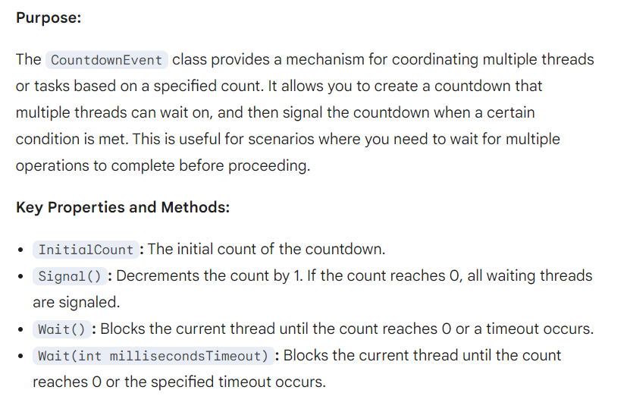

Slide 4
Real-time Scenario for CountdownEvent
Scenario: A distributed application with multiple worker nodes. You want to trigger a global operation (e.g., a database backup) only after all worker nodes have completed their current tasks.

Slide 5
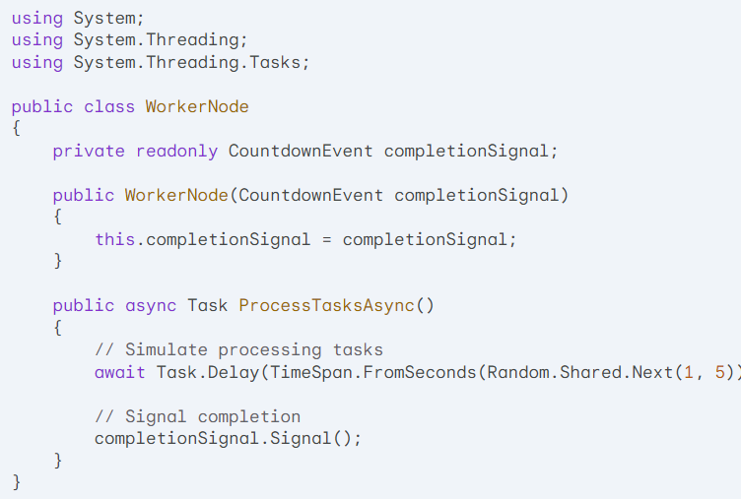

Slide 6
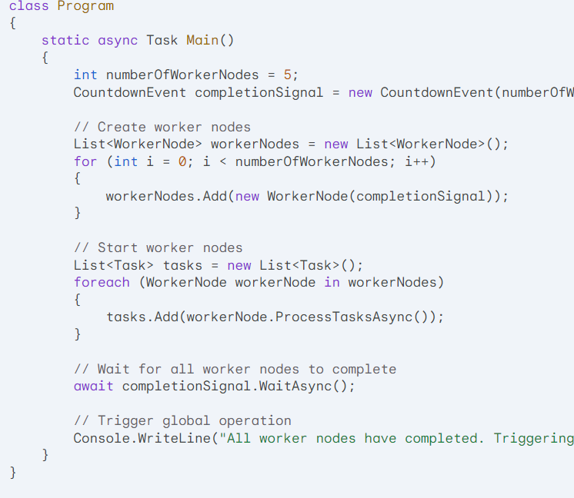

Slide 7
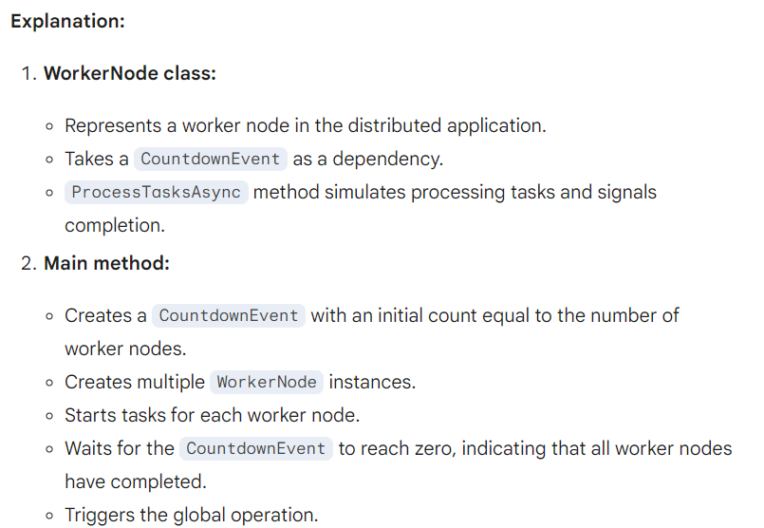

Slide 8
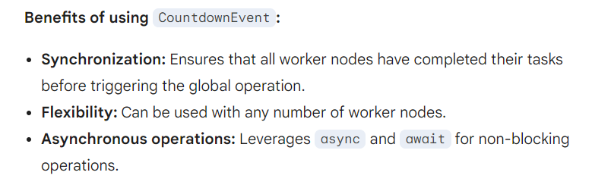

Slide 9
when there is a option to solve count down problem with interleaved combinator why we need countdowbnevent?

Slide 10
CountdownEvent:
Purpose: Used to coordinate multiple threads or tasks based on a specified count.
Mechanism: Tracks a count and signals all waiting threads when the count reaches zero.
Use cases:
Waiting for multiple asynchronous operations to complete before proceeding.
Implementing a "cancellable" operation where a certain number of tasks must finish before cancellation is allowed.

Slide 11
Interleaved Combinator:
Purpose: A functional programming construct that combines multiple asynchronous operations into a single sequence, allowing them to execute concurrently and interleave their results.
Mechanism: Leverages asynchronous programming concepts like async and await to create a pipeline of asynchronous operations.
Use cases:
Processing data in parallel while preserving the order of results.
Combining multiple asynchronous steps into a single, sequential workflow.

Slide 12
